Slide 1



HTN in the Elderly
In the name of God
Dr. Shahrzad Shahidi
Professor of Nephrology
Isfahan University of medical sciences

Slide 2
Objects
Case presentation
Introduction
Frailty
HTN & Frailty
A systematic review of BP guidelines
Key points
Case presentation

Slide 3
Case
A 83-year-old male with a Hx of HTN since 10 ys ago has been referred for control of his BP.
He lives in a nursing home.
His daily medications are: Losartan 50 mg, Solifenacin 5 mg, vit D3 50,000 IU/m.
He has a Hx of HTN & DM in his father.
PE: BP: 145/85 mmHg, PR: 78/min, W: 75 kg H: 168 cm Fundoscopy, nerve examination, etc. are normal.
ECG: LVH.
WBC: 5400 Hb: 14.8 Plt:155000
FBS: 98 mg/dL
Cho: 148 HDL: 60 LDL: 50
TG: 190
BUN: 12 mg/dL
Cr: 1.2 mg/dL eGFR: 60 ml/min/1.73m2
Na:139 mEq/L K: 4.4 mEq/L
Ca:10 mg/dL Alb: 4.6 gr/L
U/A: SG 1.020, Pr _

Slide 4
question
  What is the target BP in this patient?
    < 130/80
    > 140/90
    < 150/80
    > 150/90

Slide 5
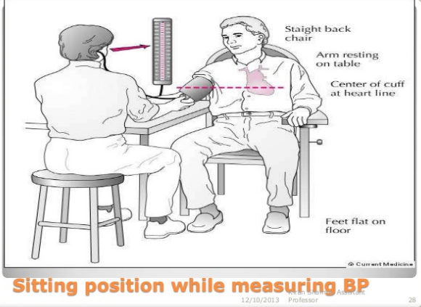

Slide 6
Introduction
Old age subgroups | Age | Old age subgroups | Age
Young-old | 60 to 69 | Young-old | 65 to 74
Middle-old | 70 to 79 | Old | 75 to 84
Old-old | ≥ 80 | Very old | ≥ 85
Forman, D. E.J of the Ame Geria Soci. 1992
Lee SB. Clin Exp Emerg Med.2018

Slide 7
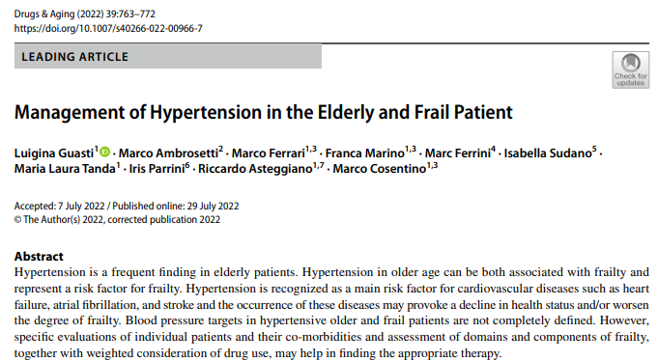

Slide 8
Introduction
HTN is a frequent finding in elderly patients.
HTN in older age can be both associated with frailty & represent a risk factor for frailty.
HTN is recognized as a main risk factor for CVD such as HF, AF, & stroke & the occurrence of these diseases may provoke a decline in health status &/or worsen the degree of frailty.
Gusti L. Drugs & aging.2022

Slide 9
Frailty
The subject of vulnerability or the global risk of patients’ inability to withstand potential acute stressors.
The classical domains that have been identified are:
  The physical domain
  The medical domain
  The cognitive/depressive domain
  The social domain
Various deficits may combine to confer a frailty status to the patient.
Gusti L. Drugs & aging.2022
Notes:
The definition of frailty includes various aspects of patient evaluation and tends to capture

Slide 10
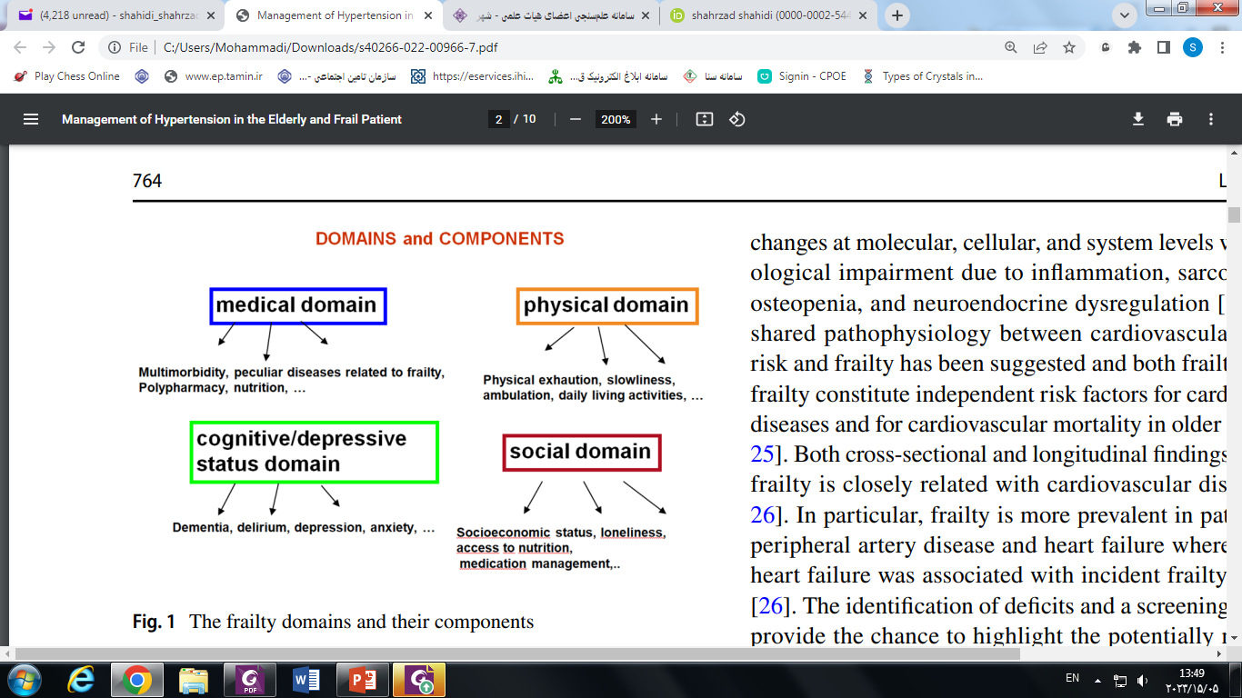
Gusti L. Drugs & aging.2022

Slide 11
Frailty
The identification of deficits & a screening for frailty provide the chance to highlight the potentially modifiable components of frailty, &, when identified, to provide a better definition of patient risk.
Gusti L. Drugs & aging.2022

Slide 12
General support & management of frailty
  Nutrition
  Exercise
  Cognitive/ emotional support
  A multicomponent rehabilitation program when needed
  Focus on environmental aspects to reduce falls
  A guarantee of social support
  Targeting of inappropriate polypharmacy
  Reducing hospitalization periods when needed
Gusti L. Drugs & aging.2022

Slide 13
Htn & FRAILTY
The prevalence of HTN is up to 80% in patients with frailty & appears to be significantly associated with lower cognitive performance & sedentary habits.
Patients with frailty may present with both low & high BP values, with a typical U-shaped relationship.
Gusti L. Drugs & aging.2022

Slide 14
Htn & FRAILTY
There is still insufficient evidence to establish a BP target in the elderly.
This population, especially patients with frailty, are often excluded from trials or are without precise identification in most studies.
However, particular subgroups of frail older persons underrepresented in clinical research are those who are institutionalized, requiring nursing, or with dementia, with a marked ‘gap in evidence’.
In addition, most large trials on HTN in older persons exclude patients with orthostatic hypotension.
Gusti L. Drugs & aging.2022
Notes:
There is still insufficient evidence to establish a BP target in the elderly [38]; this population, especially patients with frailty, are often excluded from trials or are without precise identification in most studies, and thus sufer from the lack of recommendations. When participants of the SPRING trial were characterized according to frailty measures, the patients were found to have a similar degree of frailty compared with other large trials with ambulatory patients [33]. However, particular subgroups of frail older persons underrepresented in clinical research are those who are institutionalized, requiring nursing, or with dementia, with a marked ‘gap in evidence’. In addition, most large trials on hypertension in older persons exclude patients with orthostatic hypotension, which is one major concern in treating older persons and the different domains and components of frailty are not disentangled, even in studies reporting frailty status

Slide 15
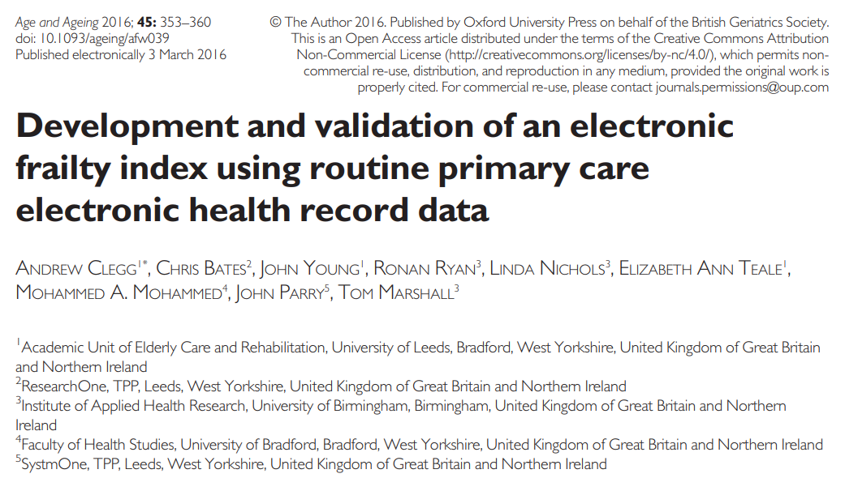

Slide 16
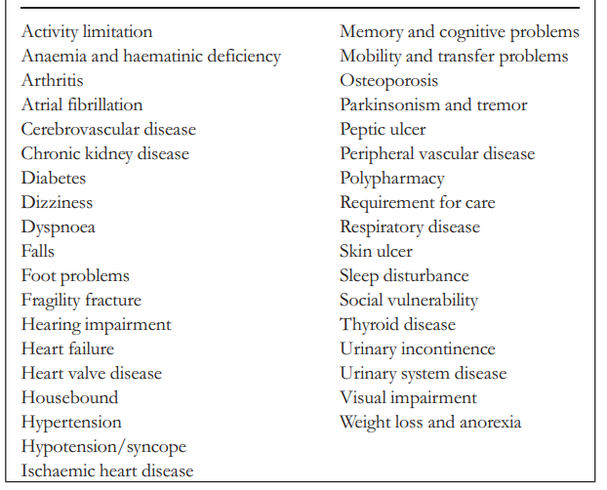
List of 36 deficits contained in the eFI
FI scores of:
0–0.12 = fit
>0.12–0.24 = mild frailty
>0.24–0.36 = moderate frailty >0.36 = severe frailty
Clegg A. Age & Ageing. 2016

Slide 17
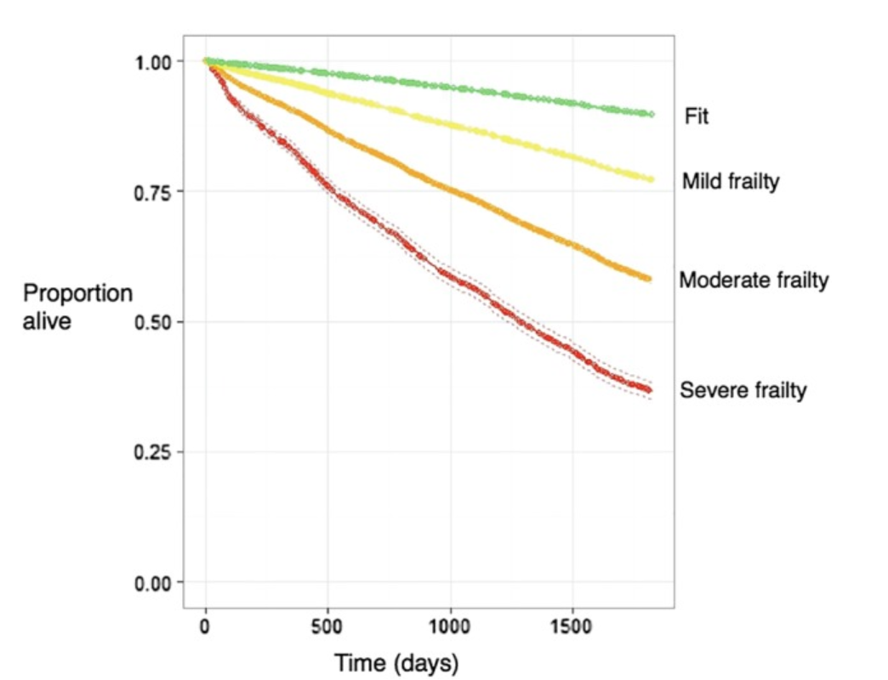
5-year Kaplan–Meier survival curve for the outcome of mortality for categories of fit, mild frailty, moderate frailty & severe frailty
Clegg A. Age & Ageing. 2016

Slide 18
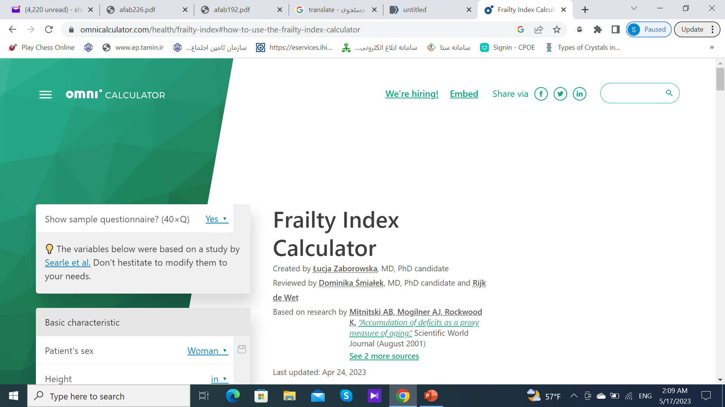

Slide 19
Conclusion
We have developed & externally validated an eFI using data from over 900,000 UK primary care patients.
It has potential for mapping to international standard coding systems.
Clegg A. Age & Ageing. 2016

Slide 20
Conclusion
The eFI enables identification of older people who are fit, & those with mild, moderate & severe frailty.
Using the eFI, increasing severity of frailty identifies older people who are at increased risk of future nursing home admission, hospitalization, longer length of hospital stay, & mortality.
Clegg A. Age & Ageing. 2016

Slide 21
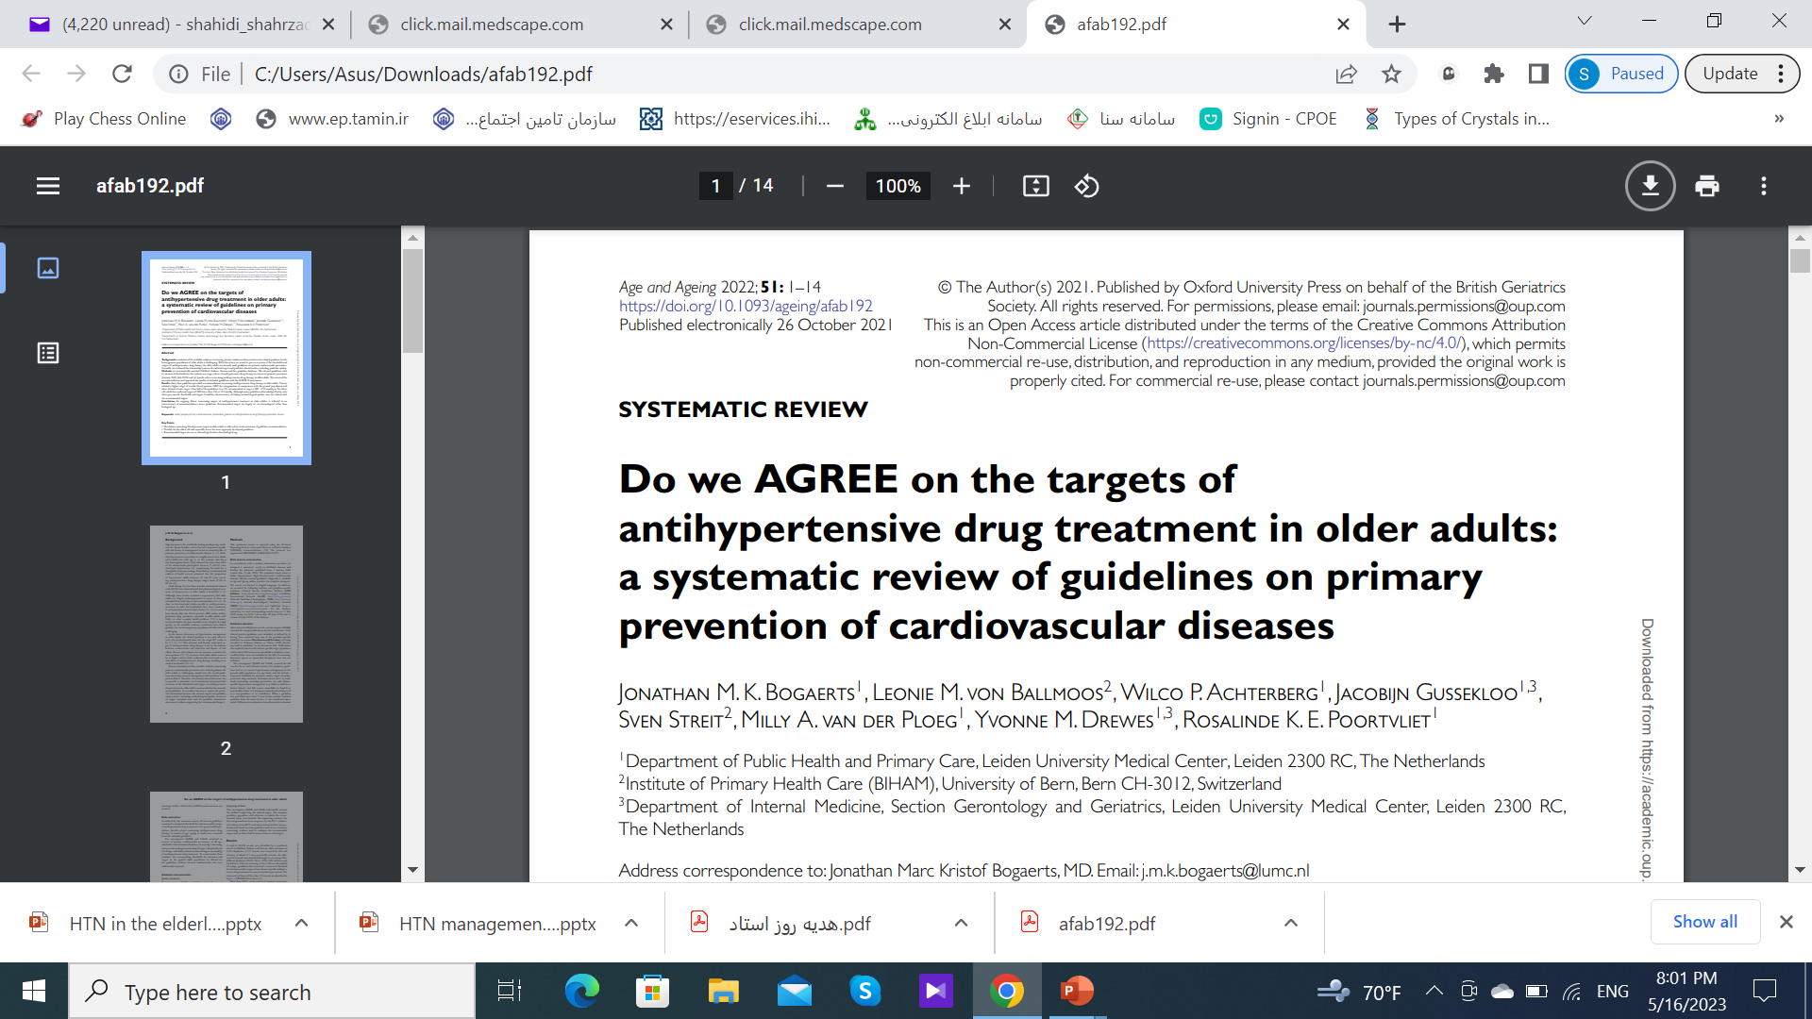

Slide 22
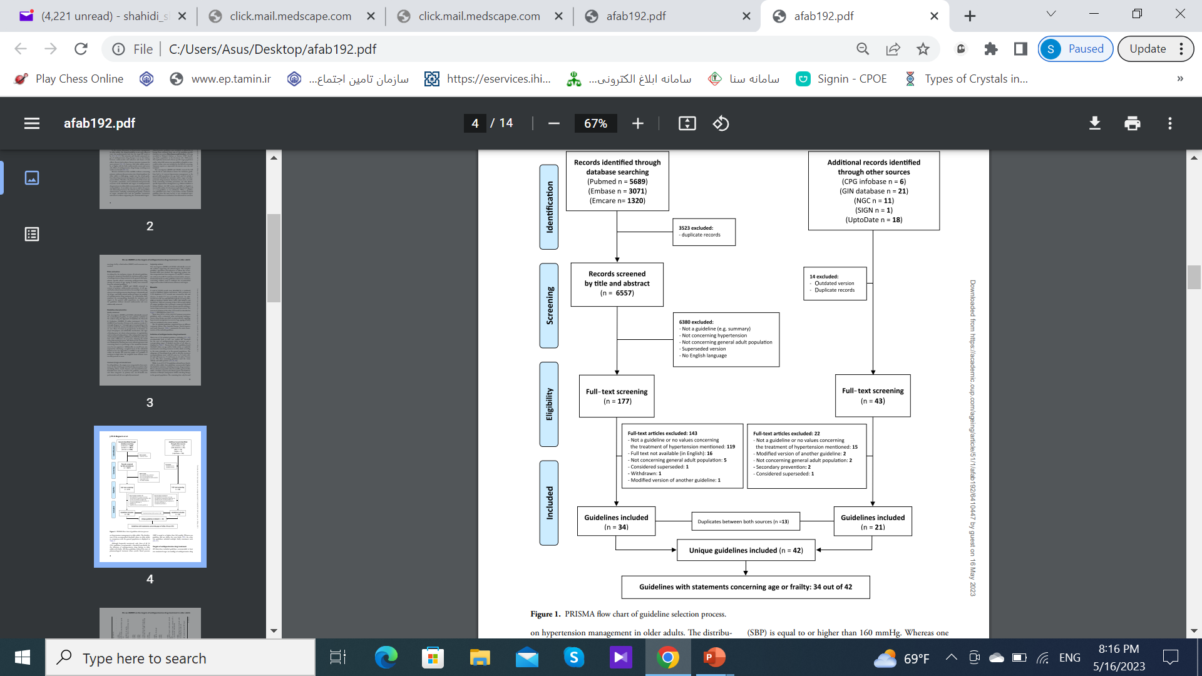
PRISMA flow chart of guideline selection process
PRISMA flow chart of guideline selection process
Africa, Asia, Australia, Europe, North America, & South America
Bogaerts JMK. Age & Aging.2022

Slide 23
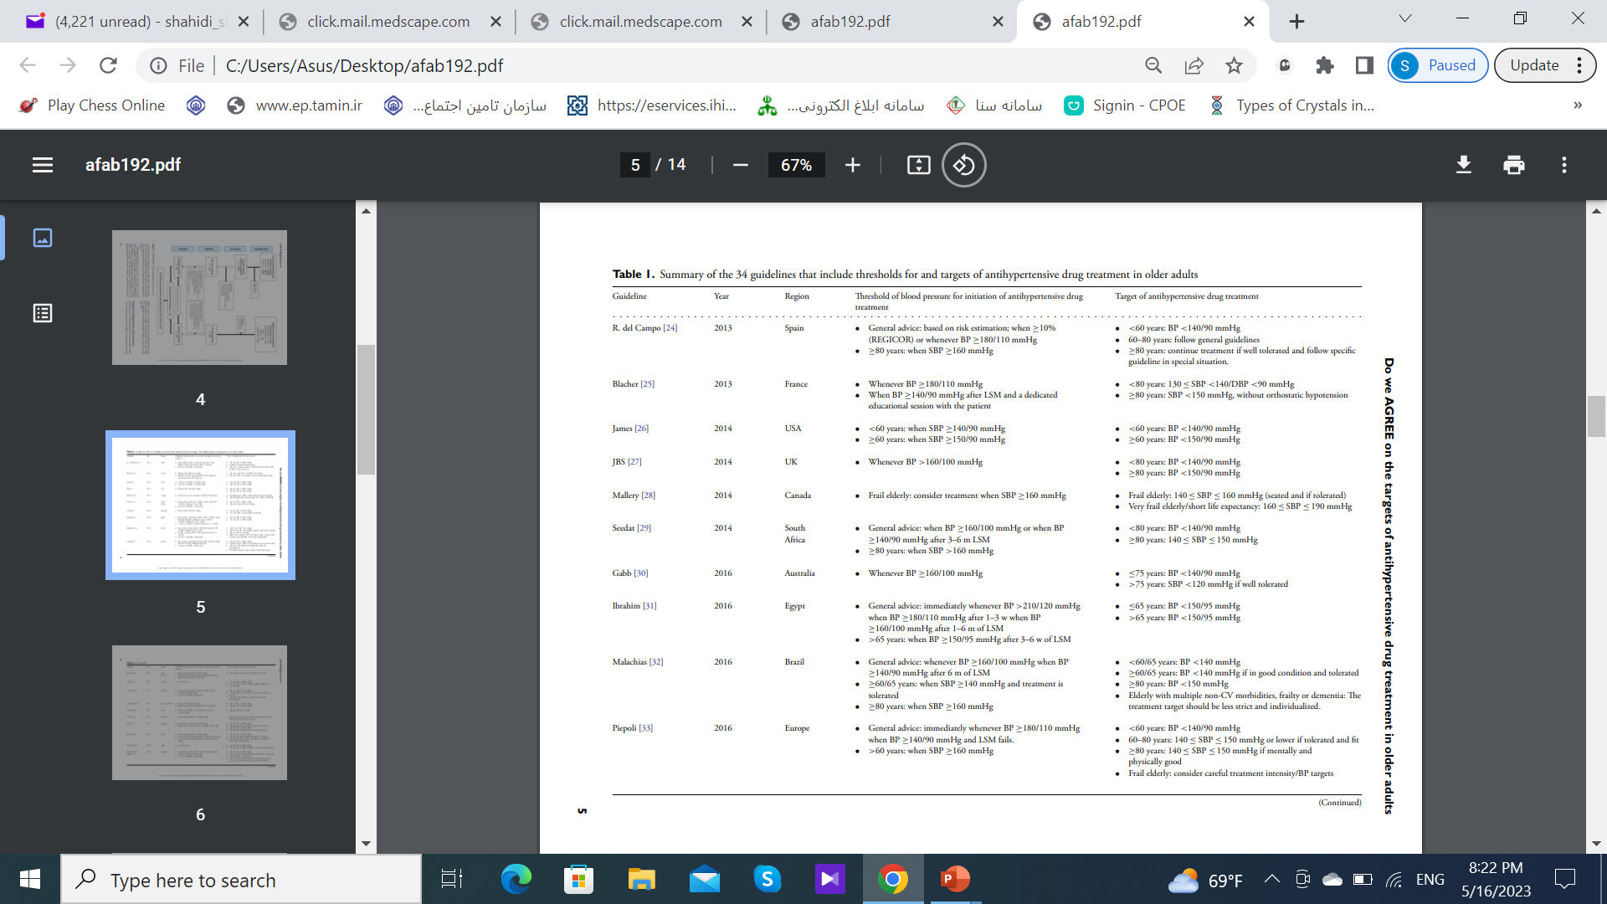
Bogaerts JMK. Age & Aging.2022

Slide 24
The subgroups of chronological age for description of targets were:
  Both ≥ 60–65 & ≥ 80 years (n = 10)
  ≥ 60–65 years (n = 9)
  ≥ 80 years (n = 6)
  ≥ 75 years (n = 5)
  Both ≥ 60 & ≥ 70 years (n = 1)
Bogaerts JMK. Age & Aging.2022

Slide 25
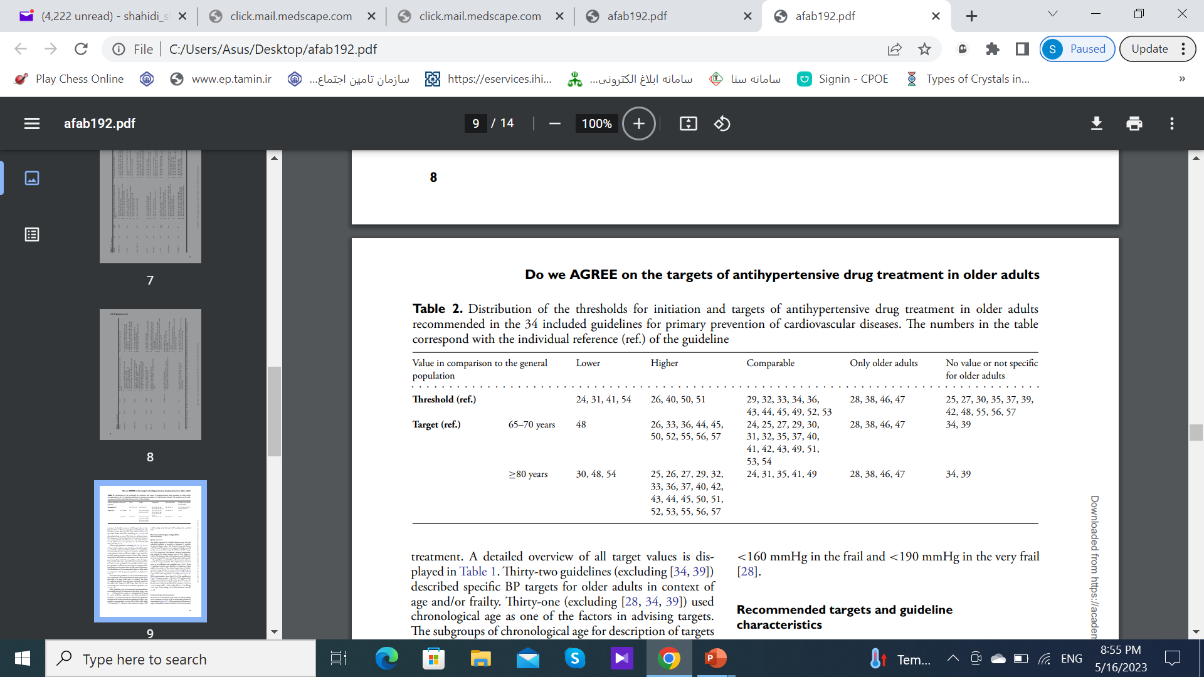
Distribution of the thresholds for initiation & targets of antihypertensive drug treatment in older adults recommended in the 34 included guidelines
Bogaerts JMK. Age & Aging.2022

Slide 26
Recommended targets in the oldest old
Targets of < 150 mmHg (43%)
Targets of < 140 mmHg (36%)
Targets of < 130 mmHg (7%)
Targets of < 120 mmHg (14%)
Bogaerts JMK. Age & Aging.2022

Slide 27
Targets of antihypertensive drug treatment
Many guidelines gave non-numerical recommendations concerning intensity of treatment in frail older adults.
Only 2 of all 34 (6%) guidelines included in the analysis advised an unambiguous target.
One guideline recommended to lower SBP in frail older adults < 150 mmHg while the other advised to target a SBP < 160 mmHg in the frail & < 190 mmHg in the very frail.
Bogaerts JMK. Age & Aging.2022
Notes:
, such as ‘ ... if tolerated but consider an individualised BP target in context of frailty, independence and likely tolerability of treatment.’

Slide 28
Conclusion
The current evidence gaps concerning targets of antihypertensive therapy for older adults, especially for the frail, necessitates scientific committees to combine trial evidence with observational data & consensus among experts for guideline development.
A large RCT is needed to provide sufficient evidence for the (de) prescribing & optimal intensity of antihypertensive drug therapy in the frail older population.
Bogaerts JMK. Age & Aging.2022

Slide 29
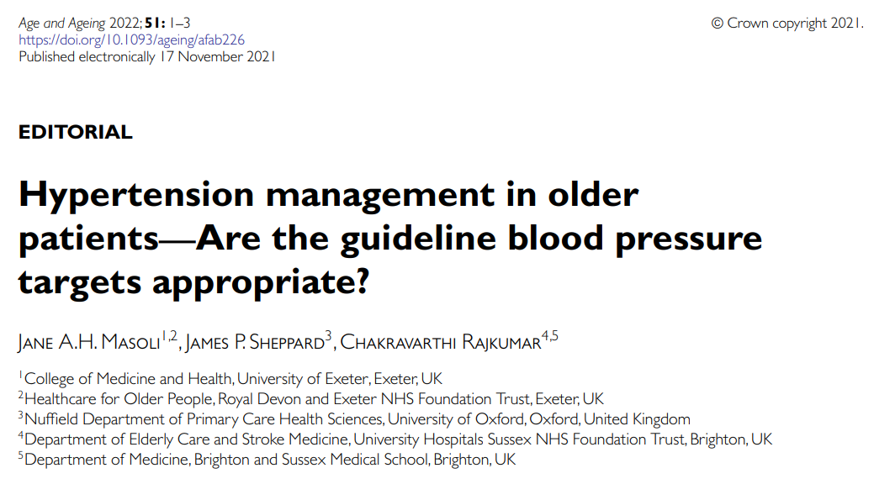

Slide 30
Htn management in older patients—Are the guideline bp targets appropriate?
Importantly, the prevention of CV risk may not be the priority for some groups of older people, particularly those with significant multimorbidity or frailty.
Masoli JAH. Age & Aging. 2022
Notes:
cardiovascular

Slide 31
Htn management in older patients—Are the guideline bp targets appropriate?
The 2019 NICE HTN guideline recommends measuring postural BP in people with:
  Postural symptoms
  All aged > 80
  Those with specific co-morbidities such as DM
with treatment to a standing BP in those with symptoms or a significant postural hypotension.
Masoli JAH. Age & Aging. 2022
Notes:
cardiovascular

Slide 32
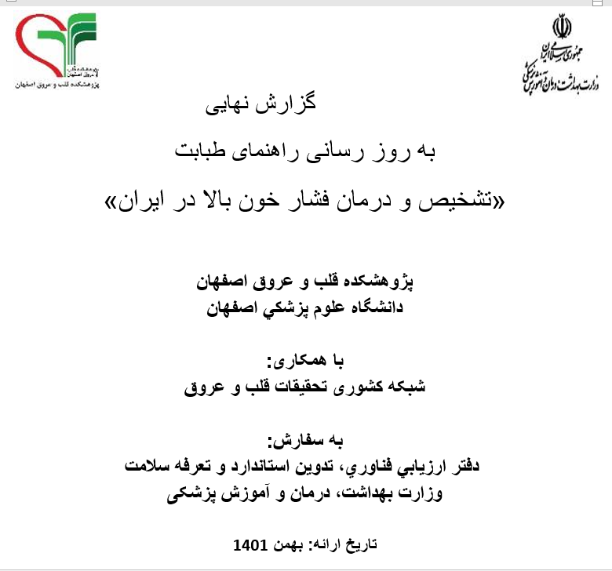

Slide 33
تشخیص و درمان فشار خون بالا در ایران
پیشنهاد می شود هدف درمان در افراد سالمند بالای 75 سال، فشارخون سیستول کمتر از 150 میلی متر جیوه و دیاستول کمتر از 90 میلی متر جیوه در نظر گرفته شود.

Slide 34
Key Points
Frailty & HTN are frequently found in the elderly & are closely interconnected.
A personalized approach is needed in the management of HTN in older persons, focusing on hypotension, co-morbidities, & adherence/persistence to medical prescriptions, while considering the specific frailty deficits.
Pharmacogenetics might help in identifying (& preventing) frailty statuses associated with pharmacological treatments.
Gusti L. Drugs & aging.2022

Slide 35
Key Points
The debate concerning BP targets in older adults is reflected in an inconsistency of guideline recommendations.
Notably for the oldest old & especially across the most rigorously developed guidelines.
Recommended targets are set on chronological rather than biological age.
Bogaerts JMK. Age & Aging.2022

Slide 36
Case
A 83-year-old male with a Hx of HTN since 10 ys ago has been referred for control of his BP.
He lives in a nursing home.
His daily medications are: Losartan 50 mg, Solifenacin 5 mg, vit D3 50,000 IU/m.
He has a Hx of HTN & DM in his father.
PE: BP: 145/85 mmHg, PR: 78/min, W: 75 kg H: 168 cm Fundoscopy, nerve examination, etc. are normal.
ECG: LVH.
WBC: 5400 Hb: 14.8 Plt:155000
FBS: 98 mg/dL
Cho: 148 HDL: 60 LDL: 50
TG: 190
BUN: 12 mg/dL
Cr: 1.2 mg/dL eGFR: 60 ml/min/1.73m2
Na:139 mEq/L K: 4.4 mEq/L
Ca:10 mg/dL Alb: 4.6 gr/L
U/A: SG 1.020, Pr _

Slide 37
question
  What is the target BP in this patient?
    < 130/80
    > 140/90
    < 150/80
    > 150/90

Slide 38
Recommendations for BP control in very old patients
Calculation of frailty index
Start with monotherapy
Slowly lower blood pressure
Individualization for target BP

Slide 39
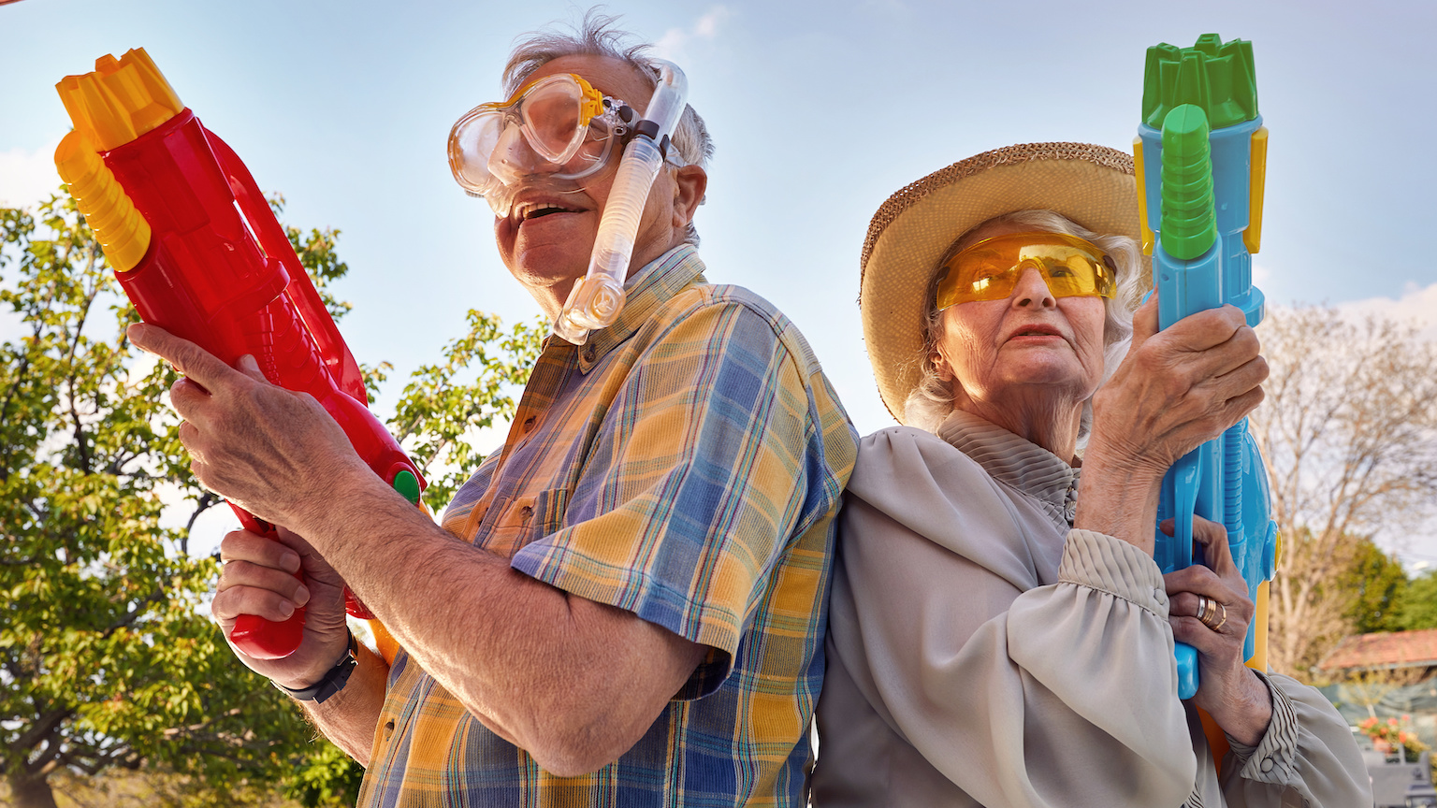
Thanks for your attention

